Slide 1
Virginia Tech/Dominion Energy Demonstration Results Report
PMU Synchroscope Analytic Demonstration Results
Tapas Kumar Barik
October 20, 2017

Slide 2

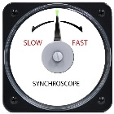



Installation Overview
The final executable PMU Synchroscope.exe file (built using openECA) is installed on the client/user system.
For testing and demonstration purpose, real time simulated PMU data are streamed in using the OPAL-RT ePHASORSIM simulator procured by Dominion Energy.
A custom modified two islanded model for the 39 bus IEEE system is generated and executed on the RT-LAB target simulator and the simulated synchrophasor data is streamed over the C37.118 protocol to the openECA instance on the client’s location.
The PMU Synchroscope installed application receives and generates signals from and to the openECA platform as described in the following slides.
PMU Synchroscope
Custom modified
IEEE 39 bus
islanded model
OPAL-RT
ePHASORSIM
C37.118 Protocol
Platform

Slide 3
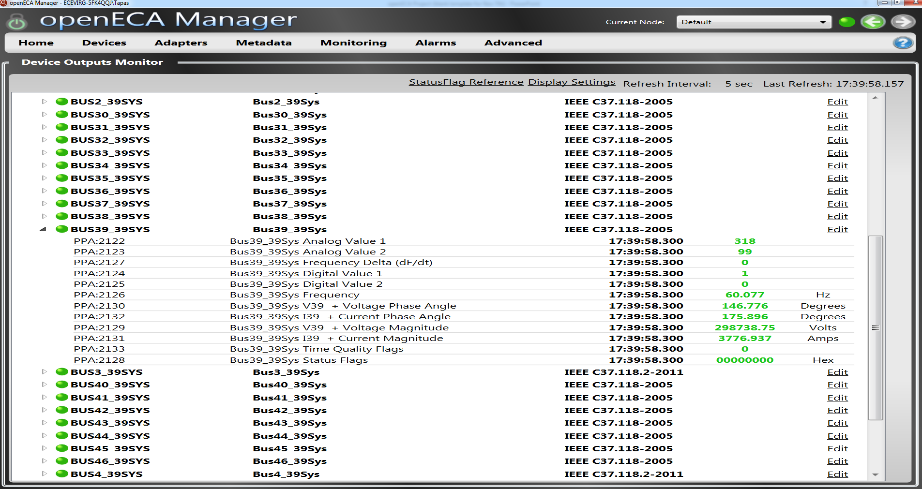
Data Stream Connection to openECA Platform

Slide 4
PMU Synchroscope Execution
Once the installed application is executed as an administrator, an Input screen pop up window appears.
The user can select the two remote buses on each island to be synchronized using the signal reference as depicted on the openECA platform.
For the custom modified model Bus 39 (Island-1) and Bus 46(Island-2) are to be synchronized and thus respective fields are filled .
Synchronizing breaker close and open commands are sent in form of voltages (0 or 5 Volts)to predefined measurement channels (required fields in the input screen) which are configured into an output stream of openECA and ultimately sent back to the simulator via C37.118 protocol.
Once all the signal references are filled up, the framework is created by clicking ENTER button and data starts streaming from openECA platform into the Synchroscope analytic.
Tolerance limits (which can be user defined as opposed to physical synchroscope hardware) are also provided and finally the Synchroscope analytic is launched

Slide 5
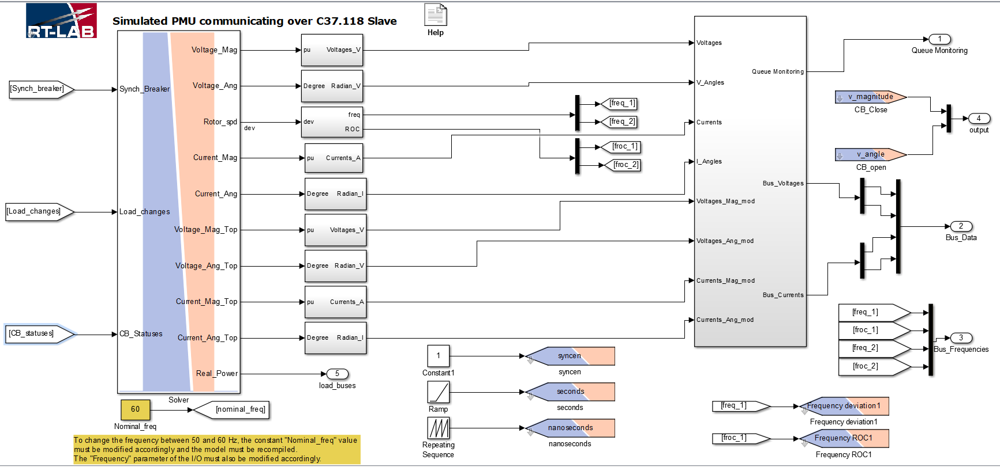
RT-LAB Simulator Custom Modified IEEE-39 Bus Model

Slide 6
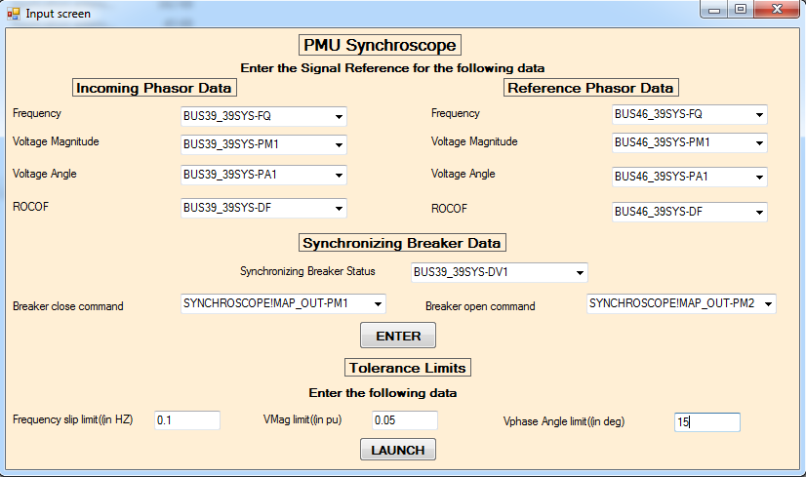
Input Screen UI

Slide 7
PMU Synchroscope Execution
Depending upon whether the incoming phasor has a frequency greater or smaller than the reference phasor, the rotating hand will move clockwise or counter-clockwise respectively as shown in the figure.
If the difference in values of frequency or voltage magnitude between both phasors are beyond limit, the checkboxes would show up in red (green if within limits).
The user can provide the downstream delay (predefined upon study of system which includes communication delay and breaker closing time delay) according to which an advanced angle(function of frequency slip and delays) is calculated and a modified tolerance angle window is generated.
Once all the necessary requirements are fulfilled, the user can initiate the breaker close command when the rotating phasor hand lies within this modified tolerance angle window.
AUTO mode is also provided for the ease of the user which senses the advanced angle at which the breaker close command should be initiated such that the actual final breaker closing is carried out with 0 degree phase angle difference(12 o’clock position)

Slide 8
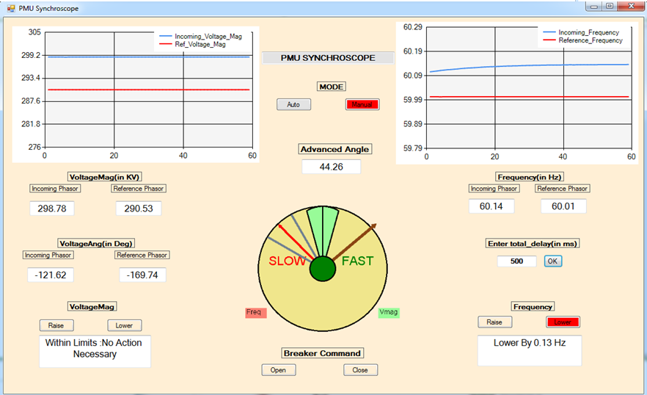
PMU Synchroscope UI

Slide 9
Demonstration Results
The application was executed with variable downstream delays and variable frequencies and successful and satisfactory response of synchronization between the two islands was observed.
The Synchronizing breaker status can be viewed as the circle in the middle of the synchroscope (Green-Open ,Red-Close)
The transients involved after the synchronization were minimal which is a indication of proper and successful synchronization.
The Synchronization breaker close and open signals generated using the analytic can be visualized on the openECA platform.
These signals for the demonstration purpose are sent back to the OPAL-RT simulator as output streams from openECA via C37.118 protocol.

Slide 10
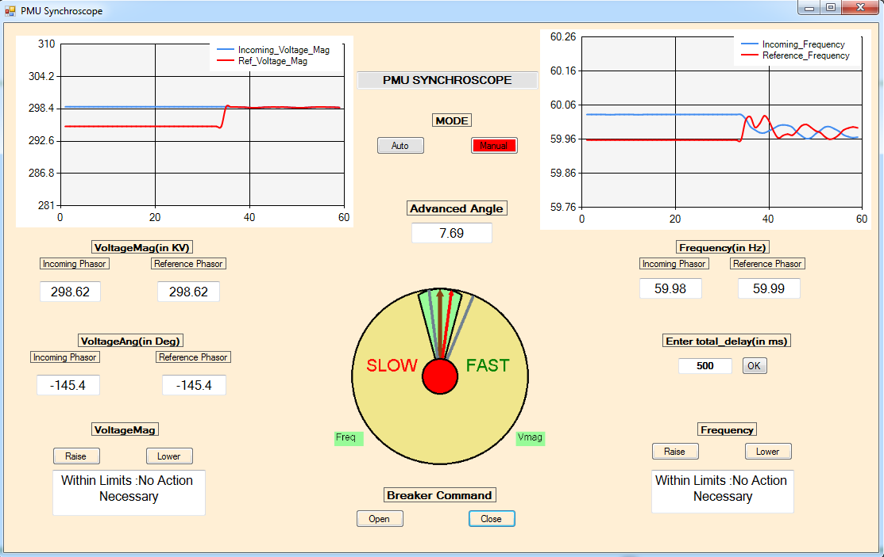
Demonstration Results

Slide 11
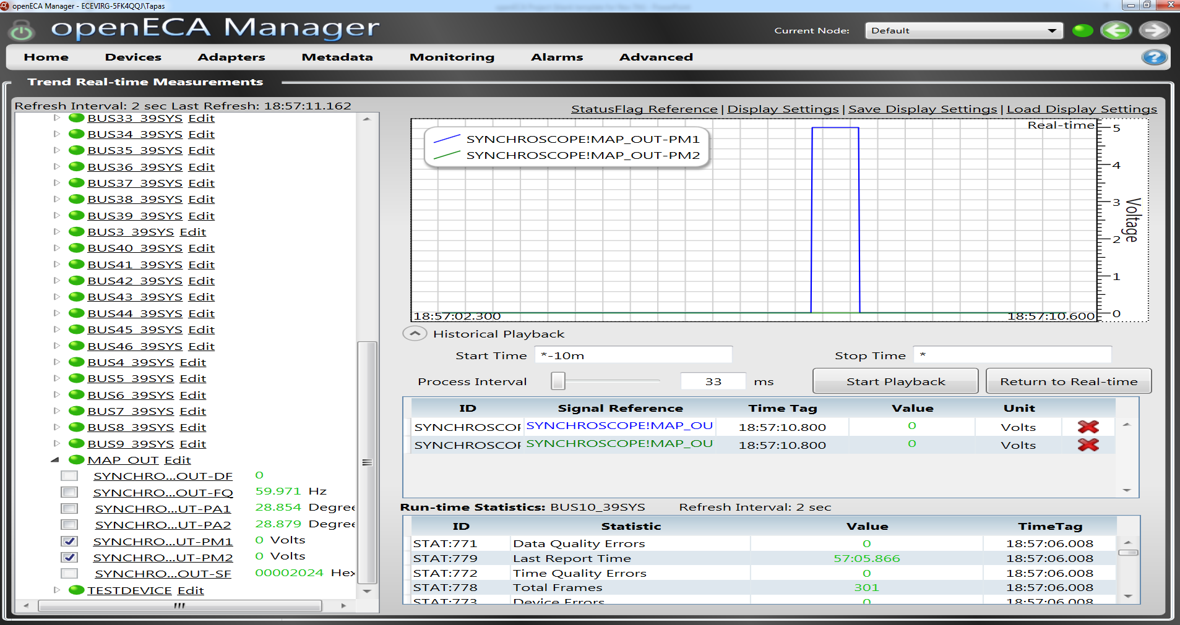
Circuit Breaker Close Signal on openECA

Slide 12
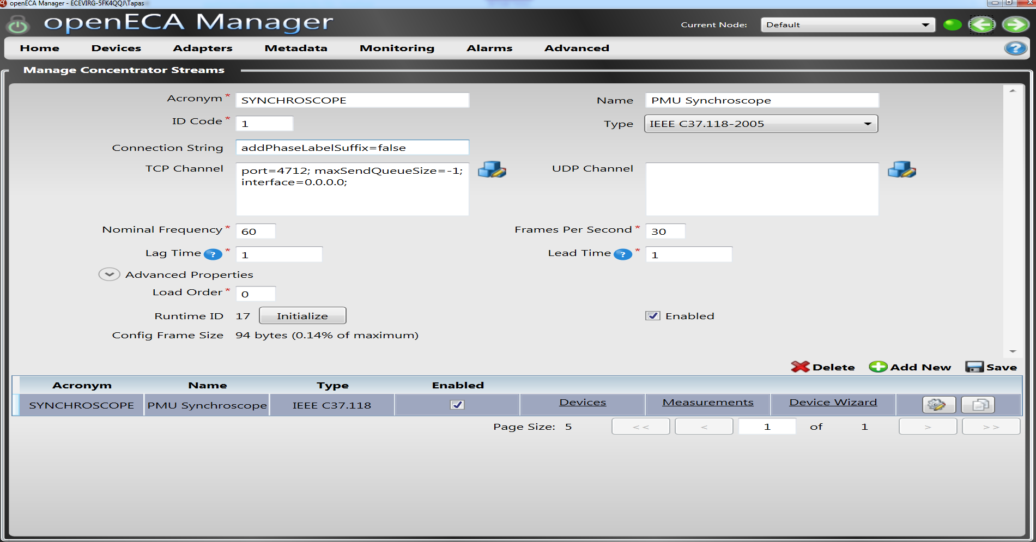
openECA Output Stream

